Slide 1
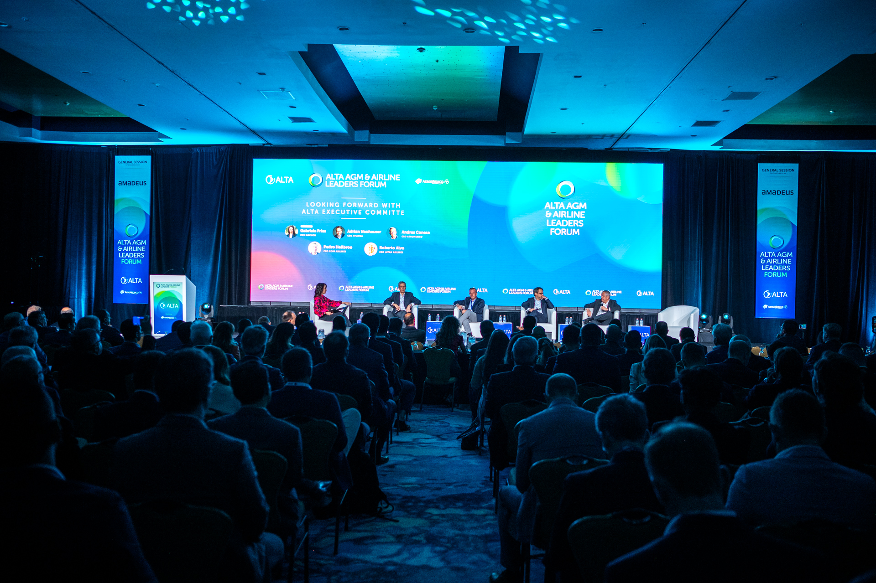
418 attendees
80+ private meetings
50+ speakers

Slide 2
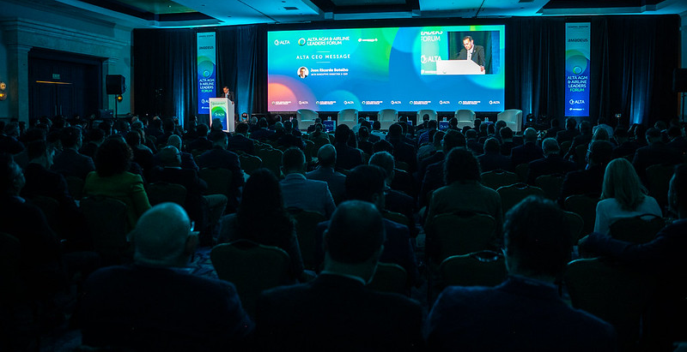
64 survey participants:
30 Supplier
8 Airline
8 Press
9 Sponsor
4 Civil Aviation Authority
3 Industry Association
2 Airport

Slide 3
Conference Agenda
Registration

Slide 4
Hotel Booking
Social Events

Slide 5
Attending ALTA FORUM was

Slide 6
TOPICS FOR 2024
State regulation and oversight
More on what airlines vision are for passenger experience
More "Future-oriented" topics linked to innovation, transformation
New trends for retailing, like NDC and One Order
AI applicable to MRO services
Distribution strategies, digital transformation and new technologies
What airlines are thinking about Cabin Experience for their passengers such as entertainment, Wi-Fi, etc
MRO development in the region: A/C, engine, components

Slide 7
SUGGESTIONS FOR 2024
Brazil should be on the radar for a future event
My recommendation is to consider during the gala dinner the participation of folklore
Would be great to include Breakfast in the exhibition area for both days and cover costs with additional sponsorship
More participation from other airlines of the region like, Volaris, Viva Aerobus, Arajet
Upcoming conferences: LIMA
Mini workshops in smaller rooms to go into more details on some topics regarding the business
The Cocktail and Dinner entertainment was amazing, but it was so loud that it makes networking conversations difficult. Otherwise the event was well done
Instead of the presentation of Oxdord Economics, I would suggest to bring Michael Lindberg (DB) back regarding the economic analysis
It would be great that ALTA consider in the press conference a review for each country. For next conferences please consider more authorities as speakers in the different panels

Slide 8
Hotel comments
The hotel was in the process of remodeling, so the experience as such was not the best
There were some mechanical issues at the hotel (the elevators) that made it difficult to get where I needed to be sometimes.
Hotel sede CARISIMO y poco funcional.
The hotel's wifi was not working appropriately.
The hotel charges additional costs that are not informed accurately when booking. I suggest checking with the hotel next year that they don't charge any additional to the room like doorbell, cleaning, resort fee, tax fee, etc.
Cancun was too expensive, taxis are brutal expensive, hotel internet was poor. Suggest that next time should make a better evaluation of the hotel and the city. Maybe cities like Buenos Aires or Quito must be considered for next events
We have lived some inconvenience with the hotel regarding a stay with breakfast since there was not an option of bed and breakfast . That's why, we chose public package instead of discounted package

Slide 9
Negative comments
Bahamas is not a good choice for the next meeting. A bigger aviation hub may be selected.
Non-members have short to non-access to airline's members.
Had not enough 1:1 meetings with C-Suite executives with the desired airlines, as requested to ALTA well in advance of this event
Expected more access to airline executives
I wish we had more opportunities to talk to airline's members

Slide 10
Positive Comments
Agenda was really good.
The CEO meetings are excellent! The press room could not be better, over 45 journalists!
ALTA is the most serious Airline event, perhaps not just for our region but globally
Each year the event is becoming stronger, that the limits of hosing is reached
Keep the 1 to 1 with CEOs
All was excellent
Todo perfecto
I consider that the content of the meetings is very complex and helps us to have an overview of thE reality of the industry in LATAM. Congratulations to ALTA for the hospitality and the effort and dedication to carry out this event
Todo muy bien y que en todos sus eventos haya servicio traducción
Enjoyed the variety of topics and presentations
Me gusta mucho el panel que armaron y los moderadores
He asistido a muchos eventos de MRO pero es la primera vez en el Alta. Nunca vi un panel de discusion tan interesante como los que armaron uds. sobre todo, el de la reportera de CNN
Maintaining the rotation of cities in the region is a good practice
Great topics and speakers

Slide 11
Positive Comments
World class event. As usual the caliber of the conference is exceptional
Great to see more airline employees
Great experience. Good networking and lots of knowledge
I always enjoy participating in the ALTA Leaders Forum because the content and agenda are relevant, and the speakers bring an unquestioned depth of experience to the panels
A wonderful experience
an enriching and very productive event
I always enjoy ALTA Leaders Forums and been a supportive since day 1!
As always, ALTA exceeds expectations! Thanks for this fantastic event!
Felicitaciones por el gran trabajo!
it is a good opportunity to have contact with high level manage of the airlines
Sumamente satisfactoria.
Very positive. I salute the leadership of Jose Ricardo in taking the organization to the next level
For us it was an event that allowed us to contact new system suppliers and new technologies, everyone was gathered in a single event which makes things easier for us for 2024
Very productive, especially the opportunity to interact with the high-level airline executives
Very good network

Slide 12
Positive Comments
Fue todo nuevo para mi, y encontrÃ© mucho valor. Espero que se repita!
A very productive, top notch, must attend conference. Can't wait for Bahamas 2024
Excellent opportunity to meet all maker decision in one event
Great networking; wonderful presentations and content
The event met my expectations
Good and productive experience. Very good panels with the CEOs
Outstanding event!
It is one of the most professional events in the travel industry
The event was excellent in terms of great information, speakers, organization, coordination.
ALTA has put together an event which only ALTA is able to !
The ALTA AGM & Airline Leaders Forum is always a particularly relevant experience since you have the opportunity to meet, listen, and interact with the region's aviation leaders and learn a little more about the complexity of the industry, and stay up to date
great evolution from last year. Would love for it to start other than Sunday. If it is going to break your weekend I rather have it starting on Thursday

Slide 13
Positive Comments
Event delivered what I have expected. Congrats to Mr. Botelho who managed event in a productive way
Great experience as always! Liked very much the cargo panel
The best event to connect with the C-levels of the LATAM & Caribbean aviation markets.
Great networking and access to airline leaders in a fantastic Latin American city that truly represents the greatness of the region
So good. Interact with decision makers has productive results since we are able to talk on strategic proposals
Un aspecto que me pareció muy bueno, y que en particular me ayudó en la cobertura, fue el que las fotos de cada jornada se subieran a Flickr. Muy buena decisión en el caso de quienes mandamos notas del día a día y que necesitamos ciertos tamaños específicos. Eso sería muy bueno mantenerlo.
También creo que hubo buen equilibrio entre los paneles y las conferencias de prensa, lo que nos permitió movernos entre unos y otros. Las conferencias de prensa creo que son un buen espacio para anuncios de la industria.

