Slide 1


ALTA Supplier Assessment Results 2021

Slide 2

Supplier assessment:
Purpose: Improve the Quality and Service of the suppliers in the Region.
• ALTA does not release the results publicly. Although we recognize the top 10 suppliers
Who is surveyed?
  In 2020: i) Suppliers that attended the CCMA of the previous year (285 suppliers) and ii) Airlines conducted bussiness with in 2019.
  In 2021: i) Suppliers that attended the CCMA the previous year (74 suppliers) and ii) Airlines conducted bussiness with in 2020. iii) All Supplier that where surveyed in 2020 by at least 4 Airlines (46 suppliers)
Parameters:
  Quality: Technical reliability and quality of the material offered by the supplier.
  TAT: Turn around delivery time of the components/materials.
  Customer support and documentation: Timely support, appropriate certified documentation and customer support.
Scores: 1 Poor, 2 Fair, 3 Good, 4 Very good, 5 Excellent

Slide 3
Supplier assessment:
Answered by the purchasing departments of the Airlines. In 2021, we include the maintenance department of the Airlines (exclude the question on TAT).
Provide a general feeling from the Airlines of the Region.
Imperfect / Perception survey: if an event occurs during the time of survey it may affect the results. Feedback may refer to an specific topic and not the general service.
To rank a supplier, it must be assessed by at least 4 Airlines.
Annual assessment (5th year).
Survey was conducted from mid-March to mid-April 2021

Slide 4
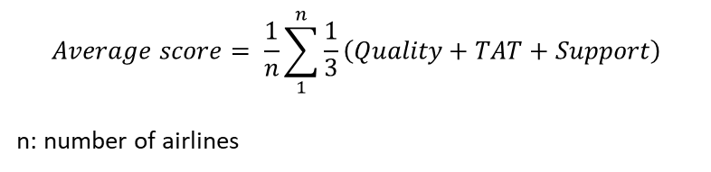
Final score:
$$\left(average score∙98\%\right)+\left(average∙\# airlines∙2\%\right)$$
4
Don´t take into account the number of airlines
Take into account the number of airlines
$$Average score= \frac{1}{n}\sum_{1}^{n}{\frac{1}{3}\left(Quality+TAT+Support\right)}$$
n: number of airlines
Where:
Notes:
If a supplier is assessed by more that 4 airlines , it will have additional points.
Supplier with most answers: 15

Slide 5
Airlines participants in the assessment
2021
2020
# | Company | Maintenance | Purchasing | Both
1 | Aerolineas Argentinas |  | a
2 | Aeromar | a | a | a
3 | Aeromexico | a
4 | Aerounion |  | a
5 | Amaszonas | a | a | a
6 | Arjet Airlines |  | a
7 | Avianca | a | a | a
8 | Azul |  | a
9 | Bahamas Air |  | a
10 | BOA | a | a | a
11 | Caribbean Airlines | a | a | a
12 | COPA | a | a | a
13 | GOL | a | a | a
14 | Itapemirim | a | a | a
15 | Latam Brasil | a
16 | RIMA | a
17 | Sky | a
18 | Tropic Air | a
19 | TUM Aerocarga |  | a
20 | Viva Air | a | a | a
21 | VivaAerobus |  | a
 | Total | 14 | 16 | 9
# | Company
1 | Aeromexico
2 | Avianca
3 | Azul Linhas Aereas
4 | Copa Airlines
5 | Ecojet
6 | Fly Montserrat
7 | GOL
8 | Latam
9 | Liat Airlines
10 | Tar Aerolineas
11 | Tum Aerocarga
12 | Viva Aerobus
13 | Vivaair

Slide 6
Airlines participants in the assessment
2021
2020
# | Company | Maintenance | Purchasing | Both
1 | Aerolineas Argentinas |  | a
2 | Aeromar | a | a | a
3 | Aeromexico | a
4 | Aerounion |  | a
5 | Amaszonas | a | a | a
6 | Arjet Airlines |  | a
7 | Avianca | a | a | a
8 | Azul |  | a
9 | Bahamas Air |  | a
10 | BOA | a | a | a
11 | Caribbean Airlines | a | a | a
12 | COPA | a | a | a
13 | GOL | a | a | a
14 | Itapemirim | a | a | a
15 | Latam Brasil | a
16 | RIMA | a
17 | Sky | a
18 | Tropic Air | a
19 | TUM Aerocarga |  | a
20 | Viva Air | a | a | a
21 | VivaAerobus |  | a
 | Total | 14 | 16 | 9
# | Company
1 | Aeromexico
2 | Avianca
3 | Azul Linhas Aereas
4 | Copa Airlines
5 | Ecojet
6 | Fly Montserrat
7 | GOL
8 | Latam
9 | Liat Airlines
10 | Tar Aerolineas
11 | Tum Aerocarga
12 | Viva Aerobus
13 | Vivaair

Slide 7
120 suppliers attended the CCMA:
13% ranked (38 suppliers)
87% didn´t fulfill the requirement to be assessed by at least 4 Airlines.
87% of the suppliers
# Suppliers included in the
ranking= 38

Slide 8

120 suppliers attended the CCMA:
70 suppliers (58%) didn´t fulfill the requirement to be assessed by at least 4 Airlines
50 suppliers ranked (41%)
# Suppliers NOT included in the
ranking= 70 (58%)
# Supplier included in the ranking = 50 (41%)

Slide 10








Airlines that participated in PPG assesment
Pablo Cichinelli
Liliana Bocanegra
Milton Ballesteros
Luis Bustillos
Daniel Cohen
Deividy Martins
Fernando Miwa
Elizabeth Erazo

Slide 11
ALTA share the Airlines that participated in the assessment, but do not disclosure to the suppliers which Airlines said what.

Slide 12
1
TAT little response and are high. Terrible service
Horroble support , every optimization request seems to be a huge favor
Rude customer support. they ran out of stock. they never have available aog materials.
For XXXX this is the worst rated vendor. They do not have materials, all dates get pushed because they don't produce enough and they have a VERY RUDE customer account manager that provides RUDE responses to the team. Escalation is not helpful either.
1. Awful communication and Customer Service: I placed this as point #1, because it is a basic that a supplier must had towards their customers. They don't answer emails on time. The topics are escalated and there is no response at all. We hold weekly executive meetings where there are commitments of dates and tasks that are not fulfilled. The customer support has holidays and no back up is generated. 2. Delays in orders: Non-compliance with delivery leadtimes, independent of the factor "Covid", "ice storm", etc. Slow manufacturing that involves constant delays. Constant changes in delivery dates. Logistical problems. 3. Financial management of the account: Very low credit limit, they release material according to the payments. No partnership. 4. Documentation: Continuous problems in documentation that generate quarantines and / or that slow down the reception of the material and therefore the flow of payments, generating a vicious circle where PPG is most of the times responsible.
2
3
4
5

Slide 13
1
TAT little response and are high. Terrible service
Horroble support , every optimization request seems to be a huge favor
Rude customer support. they ran out of stock. they never have available aog materials.
For XXXX this is the worst rated vendor. They do not have materials, all dates get pushed because they don't produce enough and they have a VERY RUDE customer account manager that provides RUDE responses to the team. Escalation is not helpful either.
1. Awful communication and Customer Service: I placed this as point #1, because it is a basic that a supplier must had towards their customers. They don't answer emails on time. The topics are escalated and there is no response at all. We hold weekly executive meetings where there are commitments of dates and tasks that are not fulfilled. The customer support has holidays and no back up is generated. 2. Delays in orders: Non-compliance with delivery leadtimes, independent of the factor "Covid", "ice storm", etc. Slow manufacturing that involves constant delays. Constant changes in delivery dates. Logistical problems. 3. Financial management of the account: Very low credit limit, they release material according to the payments. No partnership. 4. Documentation: Continuous problems in documentation that generate quarantines and / or that slow down the reception of the material and therefore the flow of payments, generating a vicious circle where PPG is most of the times responsible.
2
3
4
5

Slide 14
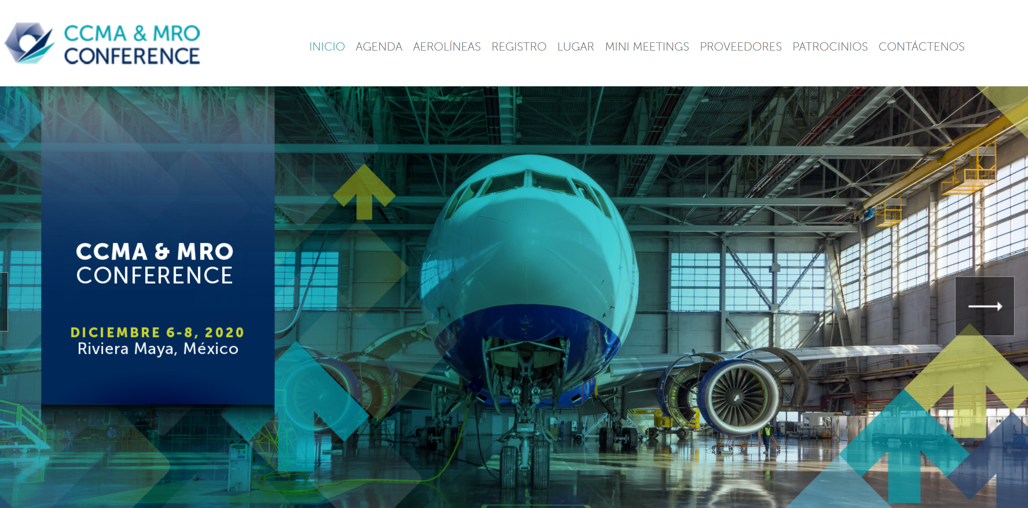

Slide 15


Thank you…
Juan Camilo Guerrero
Tech Ops and Data Manager
E-mail jguerrero@alta.aero
Phone: +1(786)547-1339 | +57(310)265-0493
ALTA_aero
ALTA Latin America and Caribbean Air Transport Assoc
www.alta.aero
Financial Park building, 23 floor, office 23 G, Costa del Este, Panama City - Panama

