Slide 1
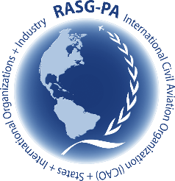
Regional Aviation Safety Group – Pan America (RASG-PA)
65th Meeting – Pan America Regional Aviation Safety Team (PA-RAST/65)

Slide 2
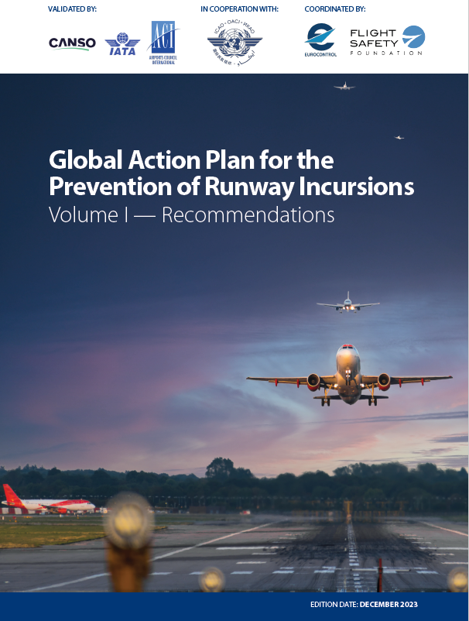
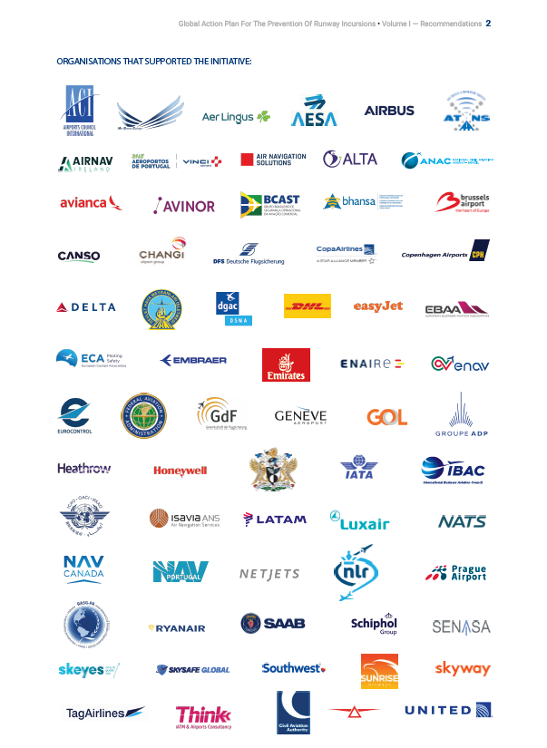
GAPPRI

Slide 3
GAPPRI
Under the leadership of ICAO, IATA, ACI WORLD, CANSO, EUROCONTROL and the Flight Safety Foundation, more than 100 organizations have contributed to GAPPRI.
Released on Aug 22, 2024.
GAPPRI Volume II aims to provide guidance and explanatory materials (GEMs), and related best practices for the recommendations listed in Vol I.

Slide 4
GAPPRI
Vol I – sets of recommendations (total 127):
Aerodrome Operators
Air Navigation Service Providers
Aircraft Operators
Manufactures
States and Regulators
R&D recommendations for States, international organizations and the industry

Slide 5
Operational Safety Diagnostic Tool for Aerodrome Risk Management – RS WG BCAST
Regulator, airlines and airports together
Safety improvement
Bow-Tie
One database for all = more efficiency
In progress (starting on site work in Oct 2023)

Slide 6
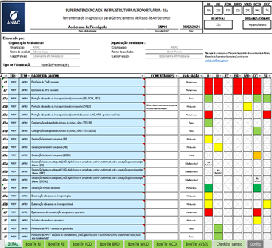
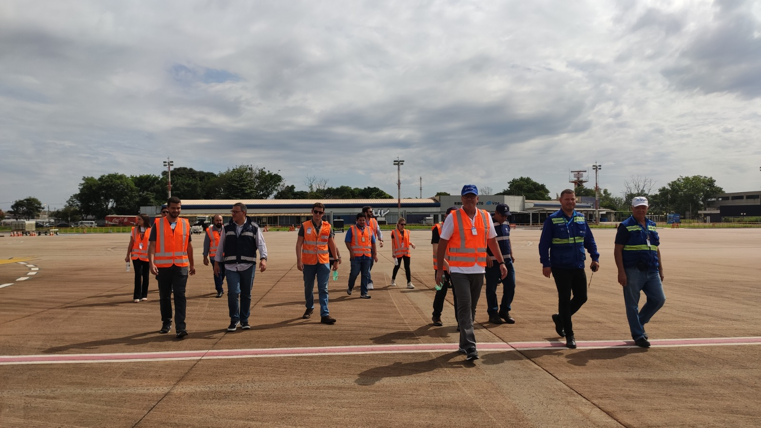
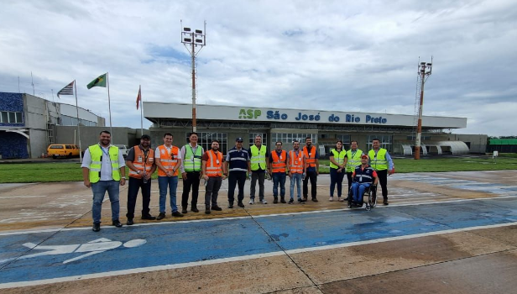
RUNWAY SAFETY
Workshop – bowtie reviweing RI and FOD – Aug/2024
1st version - 2022
2nd collaborative visit BCAST – Apr/2024
Tool improvement and dissemination project – 2024/2025
Workshop – bowtie reviweing RE – May/2024
1st collaborative visit BCAST – Oct/2023

Slide 7
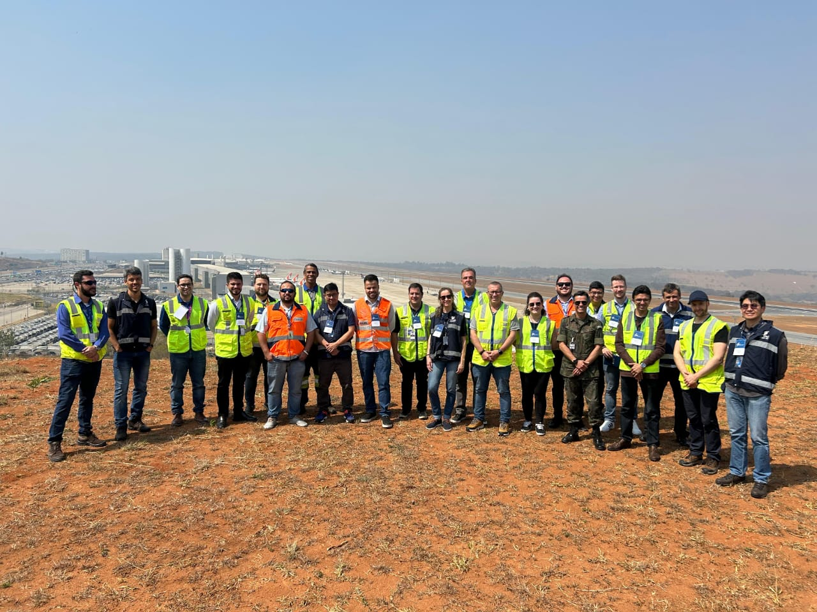
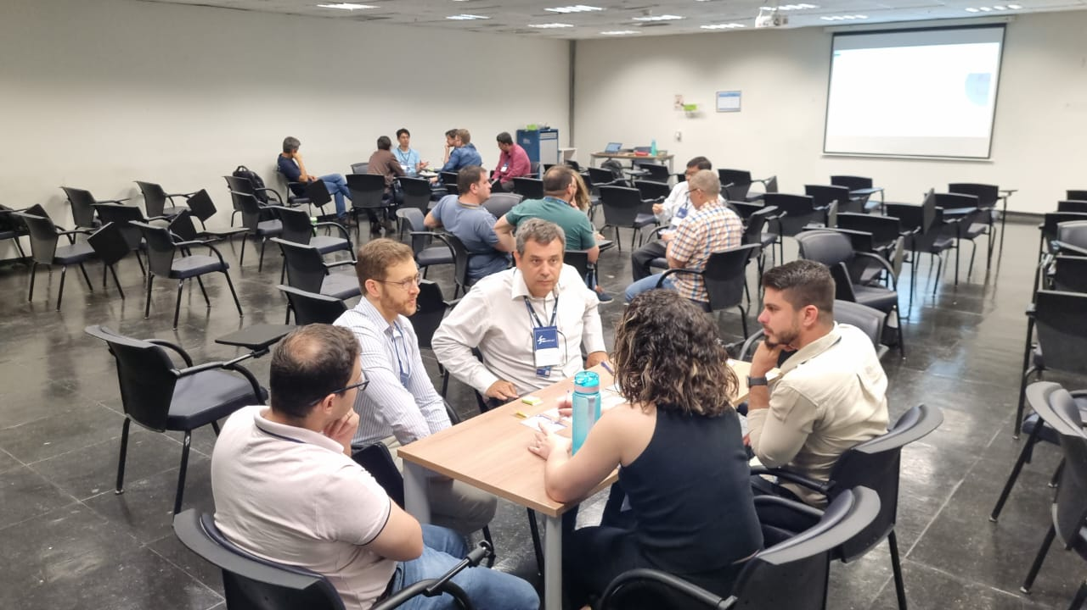
BCAST INITIATIVES
Operational Safety Diagnostic Tool for Aerodrome Risk Management – RS WG BCAST

Slide 8
Operational Safety Diagnostic Tool for Aerodrome Risk Management – RS WG BCAST
Mid-2022: SIA/ANAC developed the tool;
Since 2023: The RS Working Group has been working collaboratively to improve the tool, aiming to develop a standardized, credible tool that can be applied by ANAC, air operators, airport operators, and eventually ANAC-accredited individuals to conduct specific inspections;
In 2024: There was a need to take a further step. To this end, ANAC is drafting a Decentralized Execution Agreement (TED) with the Aeronautics Institute of Technology (ITA);

Slide 9
Operational Safety Diagnostic Tool for Aerodrome Risk Management – RS WG BCAST
BH Airport: The Working Group was able to learn about the best operational safety practices adopted by BH Airport and participate in a workshop to review the bowties for Runway Incursion, Foreign Object Debris (FOD), and wildlife currently included in the tool;
ALTA, ANAC, Azul, Azul Conecta, BH Airport, CCR Aeroportos, Gol, ITA, LATAM, and SNA.

Slide 10
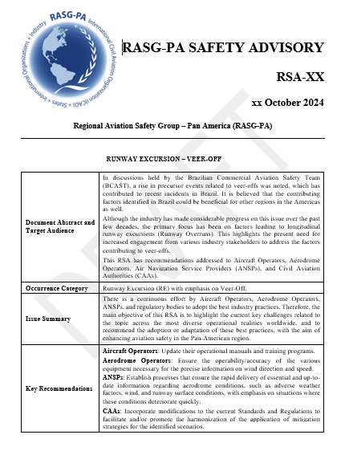
SAFETY ENHANCEMENT VEER-OFF – RS WG BCAST

Slide 11
Regional Aviation Safety Group – Pan America (RASG-PA)
65th Meeting – Pan America Regional Aviation Safety Team (PA-RAST/65)

