Slide 2
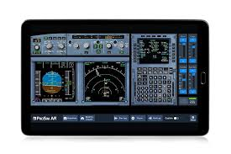
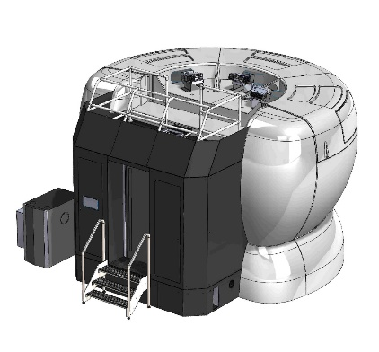
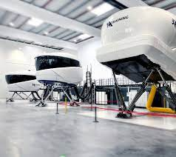
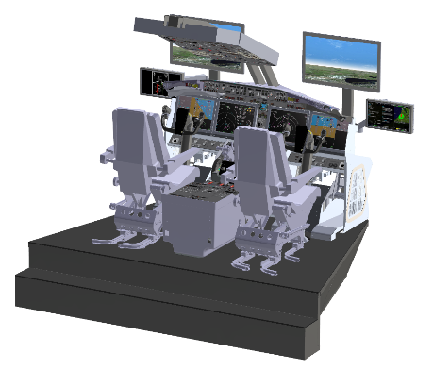
Flight Training Devices evolution enable us to offload many training hours from a Full Flight Simulator, in all phases of a pilot training
From this…
To this…
MCC
Jet Transition
Initial Type Rating (80%)
Initial Type Rating (20%)
Recurrent Training (50%)
Recurrent Training (50%)
FTD
FFS
Notes:
La tecnologia en concepto de simuladores de vuelo y su uso en el entrenamiento de pilotos, ha venido evolucionando a lo largo de los ultimos 20 anhos.
Lo mas comun en nuestra region era ver el simulador nivel D como la unica herramienta a utilizer en el entrenamiento inicial y recurrente de pilotos en aviacion comercial. Sin embargo, con la introduccion de nuevos modelos en el entrenamiento de pilotos, como el AQP (Advanced Qualification Program) y el EBT (Evidence-based training), asi como diversos estudios sobre entrenamiento basado en competencias, los fabricantes de simuladores se han adaptado a una nueva forma de dar el entrenamiento, y han creado herramientas para cada fase del entrenamiento, de tal manera, que no es ahora necesario utilizer el simulador D desde las fases iniciales, pues hay muchos FTDs que ofrecen la tecnologia apropiada en terminos de realismo del simulador, visual y otras caracteristicas, en donde puede llegar a hacerse incluso hasta un 80% del entrenamiento inicial y la mitad del entrenamiento recurrente de un piloto
The technology of flight simulators and their use in pilot training has been evolving over the last 20 years.
The most common thing in our region was to see the level D simulator as the only tool to be used in the initial and recurring training of pilots in commercial aviation. However, with the introduction of new models in pilot training, such as the AQP (Advanced Qualification Program) and EBT (Evidence-based training), as well as various studies on competency-based training, simulator manufacturers have adapted to a new way of giving training, and have created tools for each phase of training, in such a way, that it is not now necessary to use simulator D from the initial phases, since there are many FTDs that offer the appropriate technology in terms of simulator realism, , visual and other characteristics, where up to 80% of a pilot's initial training and half of a pilot's recurrent training can be done

Slide 3
Project: to standardize regulations in our region, based on ICAO Doc 9625, to allow better use of FSTDs, optimizing training, surveillance and certification processes
Phase 1
Guidance Delivery
Nov 2023
Phase 2
Workshops
Start 2024
Phase 3
Execution
Start 2025
Notes:
Un grupo de trabajo Ad-hoc conformado por las oficinas regionales de la OACI en NACC y SAM, la FAA, EASA, ALTA y COCESNA, ha tenido el mandato de los Directores de la region NACC, de crear un document guia para los Estados de la region, que basado en las recomendaciones del Doc 9625 de la OACI, permita tener armonizacion en la forma como se certifican los simuladores de todo tipo, asi como su uso. Los beneficios esperados con esta guia se resumen en: a) mejor uso del nuevo equipamiento tecnologico existente, b) optimizacion del entrenamiento de los pilotos, utilizando la herramienta correcta en cada fase del entrenamiento, c) optimizacion de los procesos de vigilancia de los Estados y los procesos de certificacion, al tener una base armonizada para desarrollar o adopter regulaciones
Las fases del Proyecto son: 1) Envio de la guia a los Estados – Nov 2023; 2) Realizacion de workshops con Estados y aerolineas sobre la guia, en el 2024, 3) Uso efectivo de la guia dentro de las regulaciones y procesos de certificacion de cada Estado.
An Ad-hoc Working Group made up of the ICAO Regional Offices in NACC and SAM, the FAA, EASA, ALTA and COCESNA, has been mandated by the Directors of the NACC region, to create a guiding document for the States of the region, which based on the recommendations of ICAO Doc 9625, It allows for harmonization in the way simulators of all types are certified, as well as their use. The expected benefits of this guide can be summarised as follows: a) better use of the new technological equipment, b) optimization of pilot training, using the right tool at each stage of training, c) optimization of States' surveillance processes and certification processes, by having a harmonized basis for developing or adopting regulations.
The phases of the Project are: 1) Submission of the guide to the States – Nov 2023; 2) Conducting workshops with States and airlines on the guide, in 2024, 3) Effective use of the guide within the regulations and certification processes of each State.

Slide 4
A futureproof system proposed by EASA (EASA RMT.0196)
EASA NPA 2020-15 states the following:
The objective of this Notice of Proposed Amendment (NPA) is to amend the EU regulatory framework with a view to maintaining a high level of aviation safety by applying an innovative approach to the capabilities classification of future flight simulation training devices (FSTDs) that ensures harmonization with the guidance established in Doc 9625 ‘Manual of Criteria for the Qualification of Flight Simulation Training Devices’ by the International Civil Aviation Organization (ICAO).
In addition, it aims at introducing a paradigm shift into the regulatory framework for initial (Flight Crew Licensing (FCL)) and recurrent (Air Operations (OPS)) pilot training.
(https://www.easa.europa.eu/document-library/notices-of-proposed-amendment/npa-2020-15)
Notes:
EASA se ha adherido a las recomendaciones del Doc 9625 y lanzo el NPA (notice of proposed amendment), un proceso para el cambio de sus regulaciones actuales para certificar simuladores de vuelo. EASA esta adoptando dicho documento dentro de sus regulaciones, lo cual representa un cambio en el paradigma de como se han certificado los simuladores en el pasado, basado en niveles, vs, la nueva forma en el Doc 9625, basado en las capacidades reales de cada simulador y las tareas a realizar dentro de cada programa de entrenamiento.
EASA has adhered to the recommendations of Doc 9625 and launched a NPA (notice of proposed amendment), a process for changing its current regulations for certifying flight simulators. EASA is adopting this document within its regulations, which represents a change in the paradigm of how simulators have been certified in the past, based on levels, vs. the new form in Doc 9625, based on the real capabilities of each simulator and the tasks to be performed within the company.

Slide 5
A futureproof system proposed by EASA (EASA RMT.0196)
Further to the paradigm proposed, training providers are required to identify the actual device capabilities (referred to as ‘FSTD capability signature’ (FCS)) based on analyzing regulatory training task objectives against FSTD features and fidelity levels enabling:
More flexibility in obtaining training credits by using other types of training devices — different from a full flight simulator (FFS);
Improvement of the visibility from the training side on the capabilities of the different devices; and
The use of new technologies in training thereby improving safety by making a clear link between FCL (type rating training) and OPS (operator recurrent training) and the Certification Specifications for Aeroplane Flight Simulation Training Devices (CS-FSTD(A)).
Notes:
Dentro de este cambio de paradigma, a los proveedores de entrenamiento se les require que identifiquen las capacidades del equipo (lo cual es referido como el sello de capacidad del simulador (FCS por sus siglas en ingles), lo cual se obtiene analizando los objetivos regulatorios de cada tarea del entrenamiento, contra las caracteristicas y los niveles de fidelidad del simulador.
Los beneficios que esperan obtenerse con esto son:
Mayor flexibilidad en obtener creditos de entrenamiento, utilizando otros tipos de equipos de entrenamiento, diferentes a un simulador FFS.
Mejora en la visibilidad desde el entrenamiento, de las capacidades de diferentes equipos.
El uso de nuevas tecnologias en el entrenamiento mejoraran la seguridad de vuelo, al hacer un vinculo claro entre el entrenamiento inicial (FCL) y el entrenamiento recurrente (OPS) y las regulaciones para certificar simuladores de vuelo (CS-FSTD(A)).
Within this paradigm shift, training providers are required to identify the capabilities of the equipment (referred to as the simulator capability seal (FCS), which is obtained by analyzing the regulatory objectives of each training task, against the characteristics and fidelity levels of the simulator.
The expected benefits of this are:
1. Greater flexibility in earning training credits, using other types of training equipment, other than an FFS simulator.
2. Improved visibility of the capabilities of different equipment for training.
3. The use of new technologies in training will improve flight safety, by making a clear link between initial type training (FCL) and recurrent training (OPS) and regulations to certify simulators (CS-FSTD(A)).

Slide 6
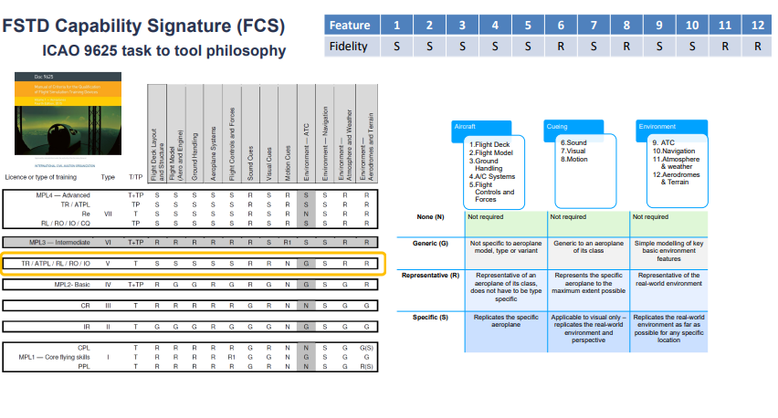
ICAO Doc 9625 at a glance
Notes:
Estos diagramas contienen algunos ejemplos del contenido en el Doc 9625 en cuanto a como se analizan los simuladores de acuerdo a capacidad y a la tarea que corresponde en el entrenamiento. Es la filosofia Tarea a Equipo (Task to Tool).
El analisis se realiza primero revisando la tarea de entrenamiento. Cada tarea indica que nivel de fidelidad se require de cada ambiente del equipo que simula una aeronave. Posteriormente, se identifica en el equipo de simulacion, que nivel de fidelidad tiene en cada uno de sus sistemas. Con base a esto, se puede determinar el sello de la capacidad de ese simulador y utilizar el equipo necesario para cada tarea de entrenamiento.
These diagrams contain some examples of the contents of Doc 9625 as to how simulators are analyzed according to capability and the corresponding task in training. It's the Task to Tool philosophy.
The analysis is first done by reviewing the training task. Each task indicates what level of fidelity is required of each environment on the equipment simulating an aircraft. Subsequently, the simulation equipment is identified at what level of fidelity it has in the simulation.
Based on this, you can determine the simulator capability signature (FCS) of that simulator and use the necessary equipment for each training task.

Slide 7
Benefits to Airlines
Economic
Safety and Human Factors
Train at home vs training off-base
Reduction of travel expenses and increased productivity
Not depending on slot demand from third party training centers
More use of less costly devices vs 100% use of FFS or aircraft
Training quality is increased – more and better training
Re-training
Self and remote training
Use of new tools to support competency achievement: Evidence-based training and Competency-based training and assessment. The right tool for the right task
Notes:
Los beneficios que se esperan con la implementacion del Doc 9625 en nuestras regulaciones para certificacion de simuladores van desde la seguridad de vuelo y factores humanos, hasta beneficios economicos.
En temas de seguridad de vuelo se espera que la Calidad del entrenamiento se mejore para tener mas ty mejor entrenamiento, asi como el uso de nuevas herramientas para alcanzar las competencias necesrias en los pilotos.
The expected benefits of implementing Doc 9625 in our simulator certification regulations range from flight safety and human factors to economic benefits.
In terms of flight safety, it is expected that the quality of training will be improved in order to have more and better training, as well as the use of new tools to achieve the necessary competencies in pilots.

