Slide 1
Pilot Training Committee Meeting
Ana Persiani, Head of Aviation Training
September 14th, 2022

Slide 2
ALTA is a private, non-profit organization at the service of the aviation industry, whose mission is to develop a safer, more efficient and environmentally responsible air transport in Latin America and the Caribbean.
Our mission is to coordinate the collaborative efforts of its members to develop a safer, more efficient and environmentally responsible air transport in the Latin America and Caribbean region.

Slide 3
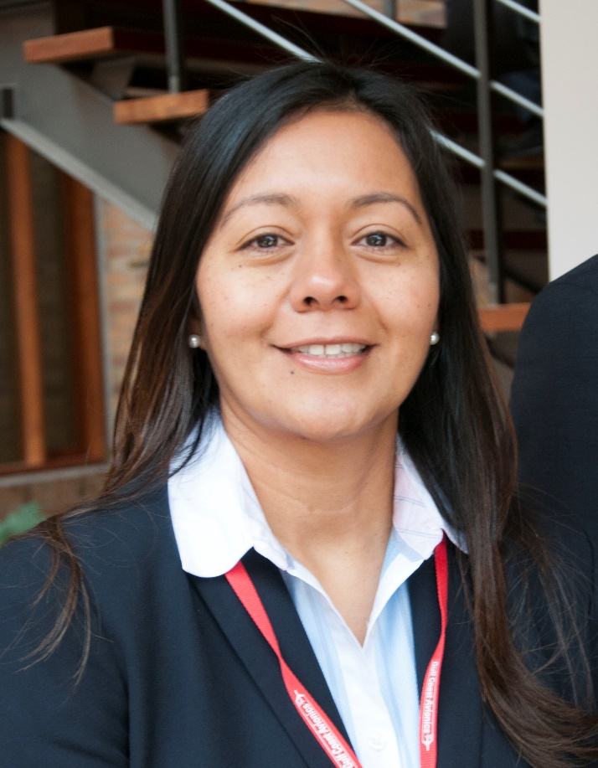
Introducing Ourselves
Ana Persiani
Industrial Engineer with a Masters degree in Finance and Diploma in Advanced Software Technology.
More tan 20 years of experience in the aviation and aerospace sectors.
TACA Airlines: Strategic Operations Management Director and Aeronautical Training Director
Mechtronix Inc. and TRU Simulation and Training (flight simulator manufacturers): Sales Director for the Americas
Aireon (space-based ADS-B data provider): Regional Director, Latin America and Caribbean.
AviatDO Consulting Group: Chief Executive Officer
Advisory Board Member for the International Aviation Womens Association (IAWA).
Partner in Conservation at WWF
Tell us about yourself: Name, Airline/Organization, Position, and Expectation of this Committee

Slide 4
People are the most important element in our industry.
ALTA’s Human Factors initiatives are geared towards making our teams shine and getting the best of them
Training Committee
Educational Hub
Stress Management Program
Enhanced Competences = Increased Efficiencies
Optimized processes = Increased Effectiveness
Improved Environment = Increased Commitment

Slide 5
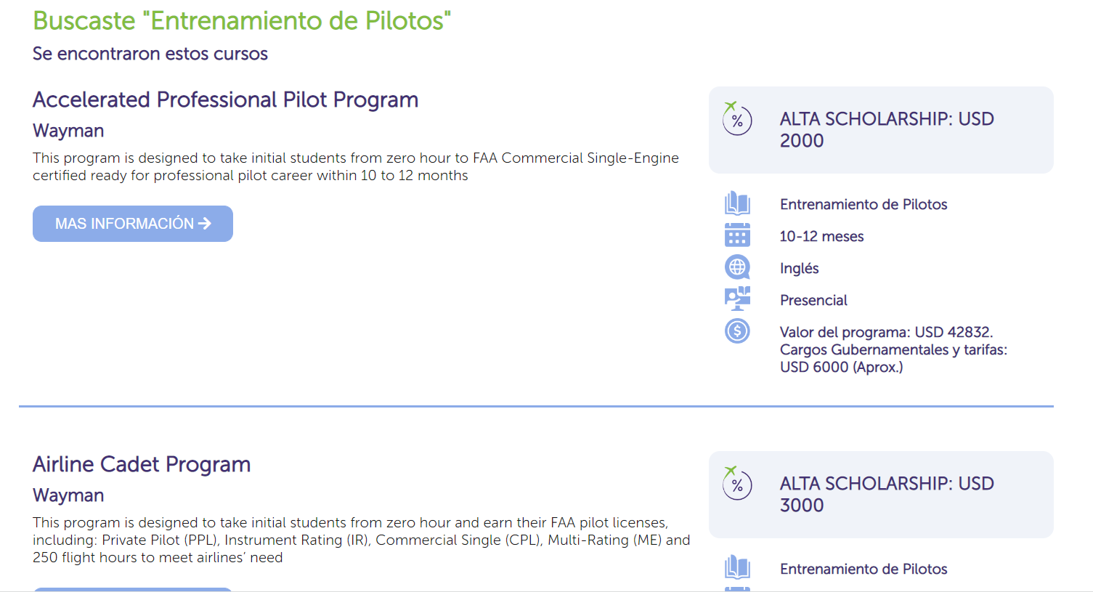
Educational Hub
Academic offering to aviation proffessionals who want to learn more, from ALTA partners highly recognized and accredited in the Industry

Slide 6
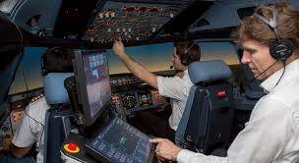
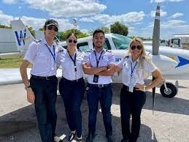
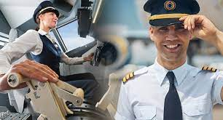
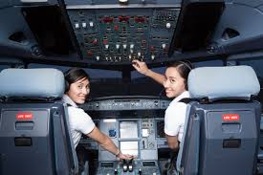
Pilot Training Committee
Mission and Objectives Review
Mission:
To promote safe, effective and efficient aviation training, aligned with the needs of the airline members
Objectives
Share best practices and experiences about pilot training in the region and to have a unified regional vision to present to the Aeronautical Authorities in matters related to pilot training
Share best practices and experiences in the creation of a pilot pipeline: pilot recruitment and training from the flight school to the operation in a commercial carrier
Share best practices and experiences in the management of Training Centers and maintenance of Flight Simulators
To work in the standardization and continuous updates of regulations in the region in relation to certification and acceptance of pilot training programs, training tools and flight training equipment
To share and educate in new trends in technology and training programs that bring value to airline members and regulators in the region
To support the well-being of the crews, through training, by incorporating the human factors aspect in discussions and development of pilot training initiatives

Slide 7
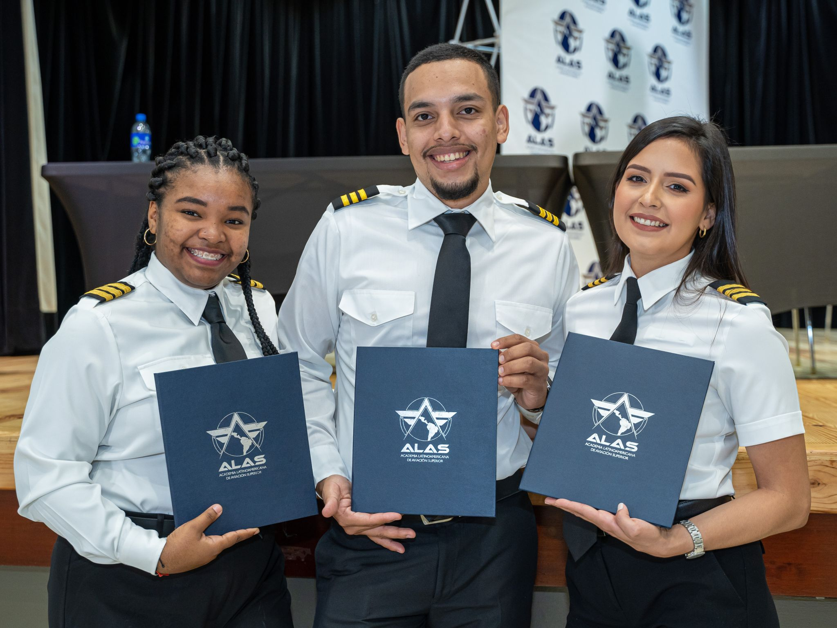
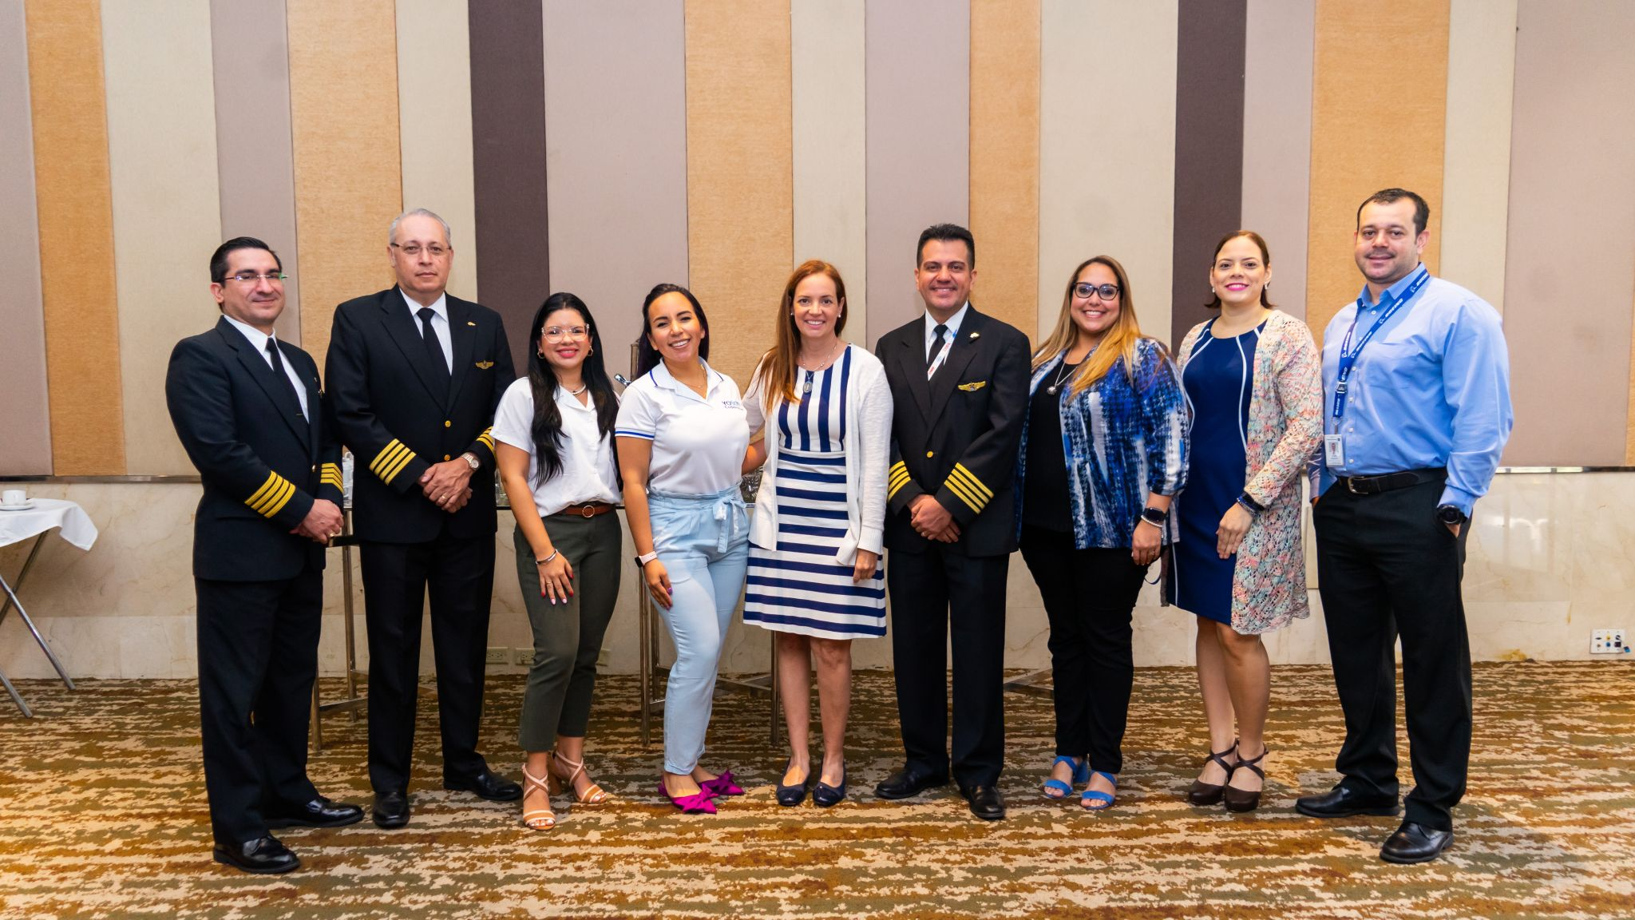
Current Pilot Training Committee Agenda
Priorities Review
Airlines pilots pipeline development
Survey with member airlines about needs, challenges and opportunities
Pilot pipeline development analysis: Finance, Technical and Operational aspects
Success cases

Slide 8
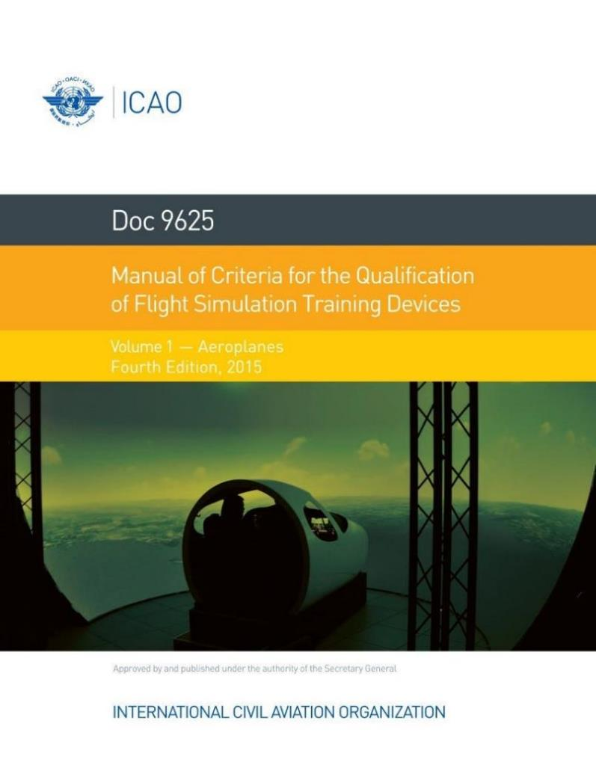
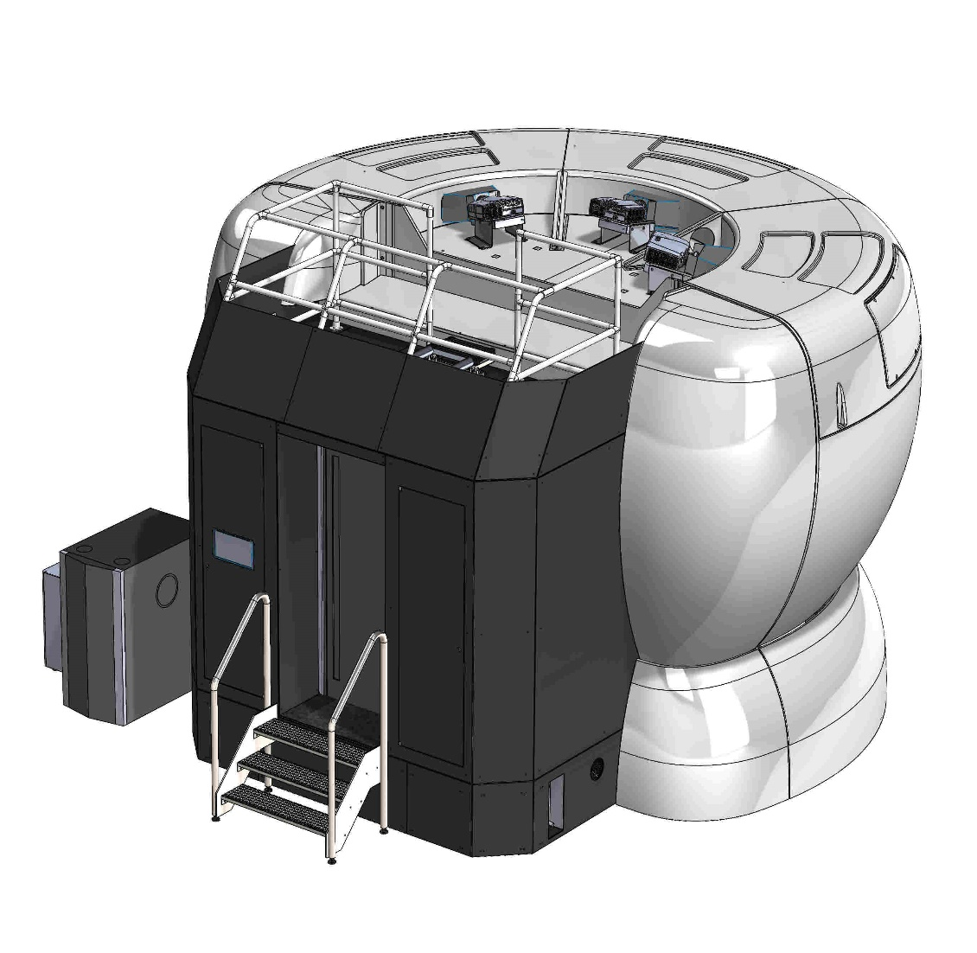
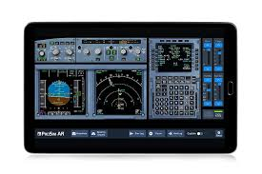
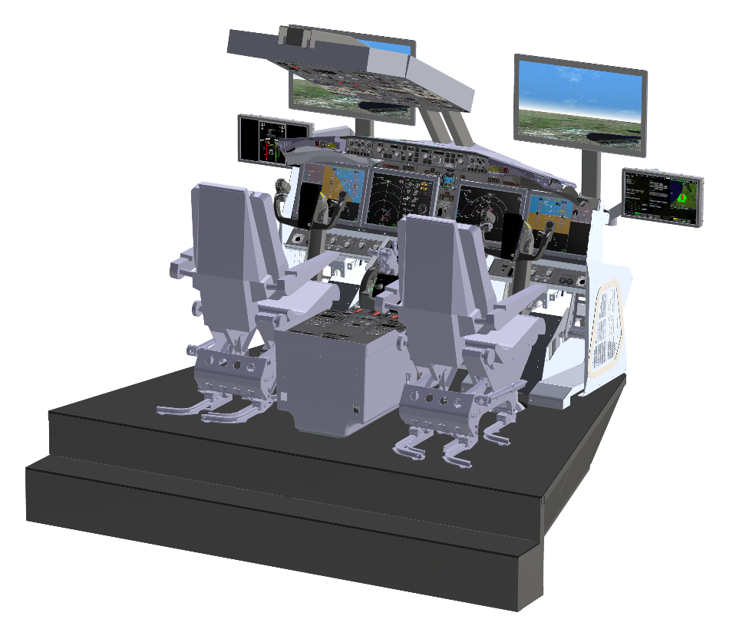
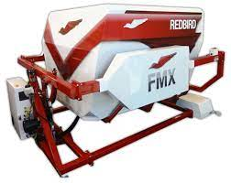
Current Pilot Training Committee Agenda
Priorities Review
Flight Training Equipment certification regulations standardization and training credits acceptance guidance development
Redbird Project
Joint work with ICAO, FAA and EASA to update and standardize regulations in the region, to unify views and acceptance of additional training credits

Slide 9
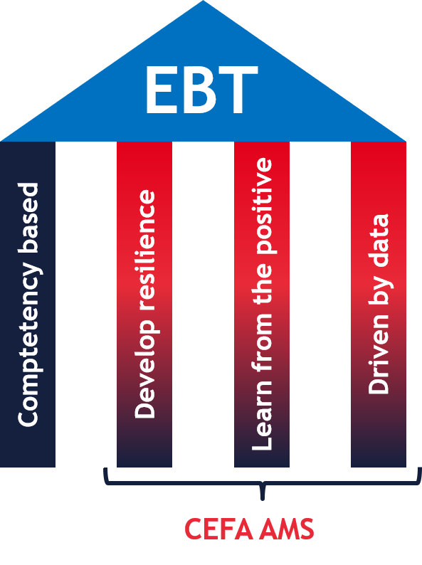
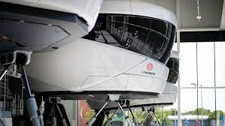
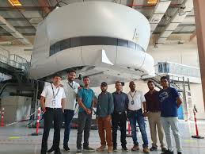
Current Pilot Training Committee Agenda
Priorities Review
Introduction of Evidence-based Training – workshops to have a better understanding about the path to follow
Training Centers Capacity vs Airlines Needs
Analysis of current region’s capacity vs airlines growth
Potential solutions

Slide 10
Committee Governance
Chairperson: Jorge Reyes
Vice-chairperson: Esteban Kertz
Co-chair: ALTA – Ana Persiani
Meetings frequency: Every two months
Next meeting: November 15th
Members:
Airline Members
Affiliate Members, as applicable
ALTA Partners, as applicable
ICAO, EASA, FAA, as applicable

Slide 11
¡Estamos juntos en este gran despegue!
ALTA_aero
ALTA Latin America and Caribbean Air Transport Association
www.alta.aero

